Slide 1
DISP: Portfolio’s Presentation Slides
IT Support Ticketing System - Supervisor: Mr Dilshan Jayatitlake - Louahche Rayan
Client : Dan Hatherall
3rd Year : DISP : development of Information System’s Project – Presentation Slides By Rayan

Slide 2
Presentation Structure:
1- Introduction
2- Overall Project realisation overview
3-Business Process Modelling (BPM)
4-System Design Development
5-Project Management
6-Quality and Configuration Management
7-Project Reflection Report
9-Live Demonstration
10-Conclusion
3rd Year : DISP : development of Information System’s Project – Presentation Slides By Rayan

Slide 3
Introduction:
Main Objective :
Implementing an efficient Ticketing System using BPMN Camunda Cloud for the client Mr Dan Hatherall
Purpose and Scope:
This project involves designing and developing a ticketing system to streamline the process of handling user tickets, using Camunda BPM for workflow management.
Team Members:
Rayan Louahche (Project Lead & Developer)
3rd Year : DISP : development of Information System’s Project – Presentation Slides By Rayan

Slide 4

Project Overview:
Agreed Client Requirements:
-Implement a functional operational BPMN model.
-Allow users to create tickets via the website and email.
-Enable email notifications and store tickets in a database.
-Provide ticket management and forms to handle user input.
-Ensure error handling, survey creation, and process termination.
-Include Reporting and analytics for project completion.
Project Goals:
-Automate and optimize the ticket management process.
-Ensure user-friendly interfaces for ticket creation and management.
-Implement a robust system with data validation and persistence.
3rd Year : DISP : development of Information System’s Project – Presentation Slides By Rayan

Slide 5
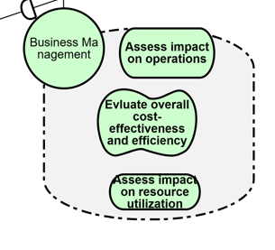
Business Process Modelling (BPM)
BPMN Design:
-Overview of BPMN and its importance in process modeling.
-Description of the BPMN diagram create.
Operational-Level Models:
The key operational-level in the BPMN diagram.
Highlight processes like ticket creation, ticket management, and survey handling.
Tools and Techniques:
Tools: Camunda Modeler,Camunda Cockpit Camunda Cloud, Zeebe Client
Techniques: BPMN for process modeling, iterative refinement.
File Format:
Operational BPMN Delivered in a .bpmn file format.
3rd Year : DISP : development of Information System’s Project – Presentation Slides By Rayan

Slide 6
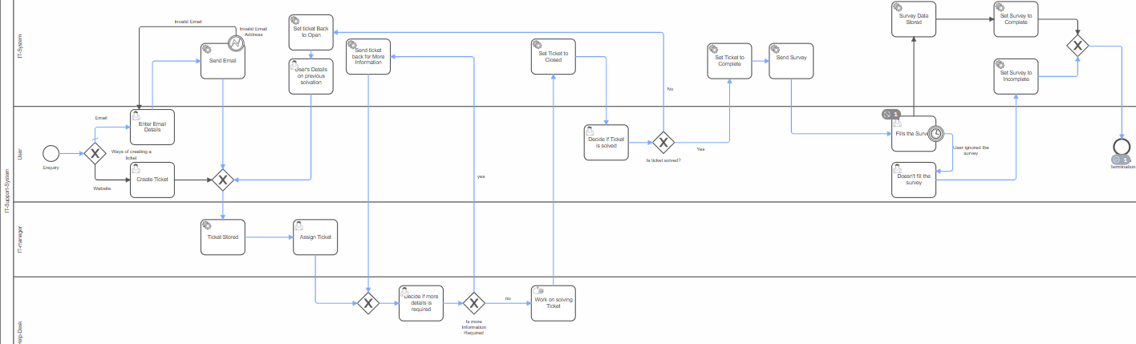
Screenshot of the BPM Operational model used:
Project Repository : Link to My GitHub :
3rd Year : DISP : development of Information System’s Project – Presentation Slides By Rayan

Slide 7
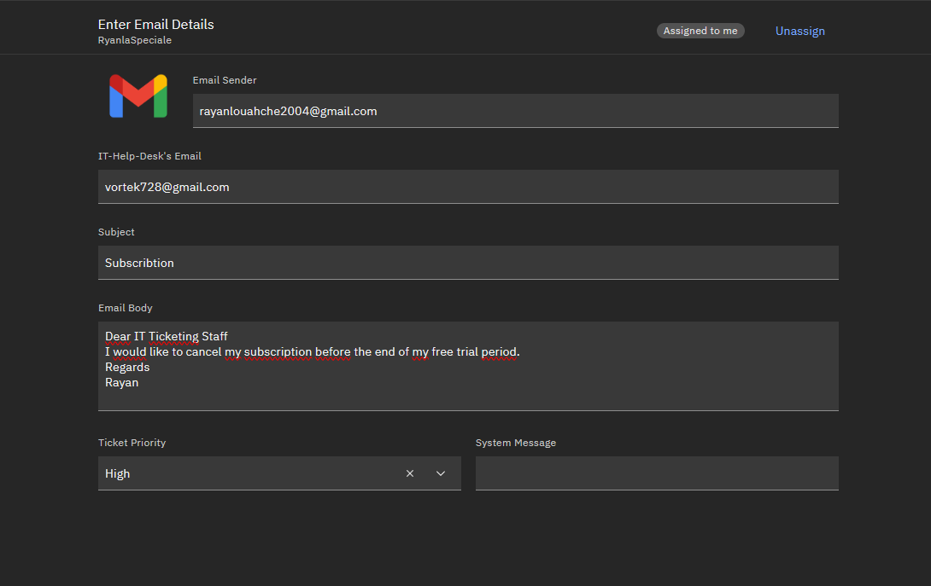
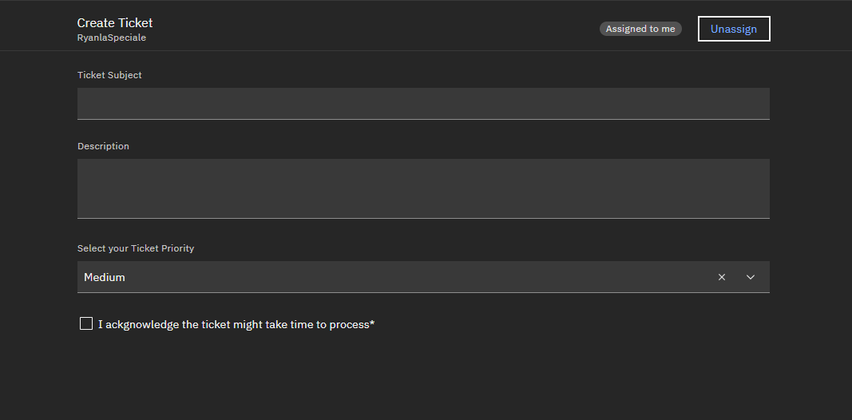
System Design and Development: User Interface
-User Interface for creating a ticket via Email
3rd Year : DISP : development of Information System’s Project – Presentation Slides By Rayan

Slide 8
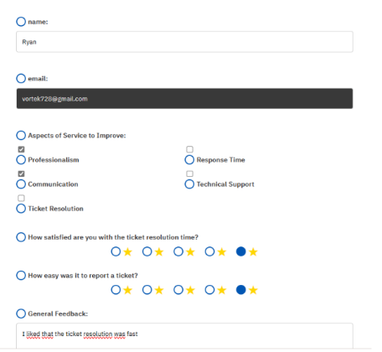
System Design and Development: User Interface
-User Interface for creating a ticket via Web
3rd Year : DISP : development of Information System’s Project – Presentation Slides By Rayan

Slide 9

System Design and Development: User Interface
-User Interface for The Survey
3rd Year : DISP : development of Information System’s Project – Presentation Slides By Rayan

Slide 10
System Design and Development: Technologies Used
-Camunda Forms combined with HTML and CSS for user input or overall user tasks.
-IntelliJ IDE as a dev tool
-Java for service tasks.
-GMAIL for http and SMTP Requests
-MongoDB for database management.
-Docker Desktop for containerization.
3rd Year : DISP : development of Information System’s Project – Presentation Slides By Rayan

Slide 11
System Design and Development: Key Features
-Reusability of components.
-Data validation mechanisms.
-Efficient workflow execution.
-Persistent data storage in MongoDB.
3rd Year : DISP : development of Information System’s Project – Presentation Slides By Rayan

Slide 12
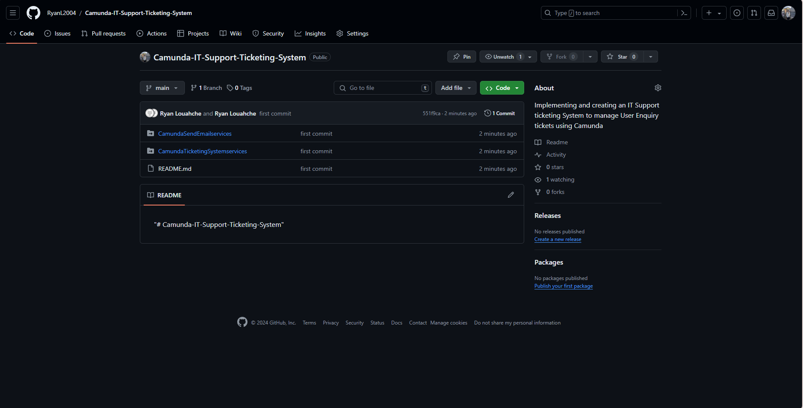
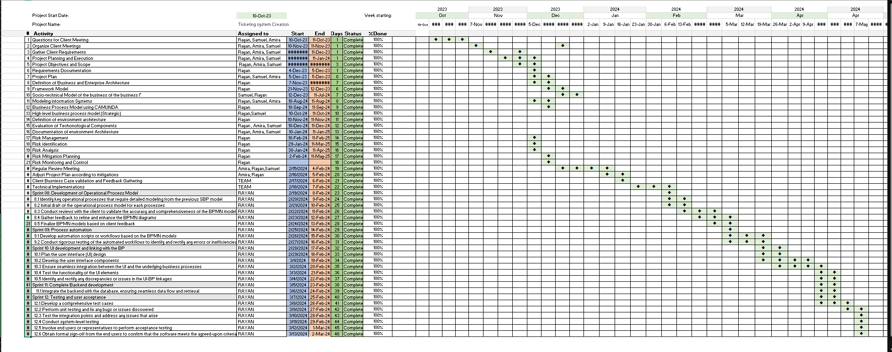
Project Repository: ( Stopped using GitLab Ultimately after Splitting from my old Group )
Project Repository : Link to My GitHub : https://github.com/RyanL2004/Camunda-IT-Support-Ticketing-System
3rd Year : DISP : development of Information System’s Project – Presentation Slides By Rayan

Slide 13
Project Management : Gantt Chart
3rd Year : DISP : development of Information System’s Project – Presentation Slides By Rayan

Slide 14
Project Management: Individual Development Methodology
Project Plan:
Gantt chart showcasing timelines and milestones.
Key phases: Planning, Development, Testing, Deployment.
Risk Mitigation:
Identified risks: Insufficient Camunda knowledge, time management.
Mitigation strategies: Self-education, detailed planning.
Client Interaction:
Summary of meetings and communications with the client.
Key decisions and feedback.
3rd Year : DISP : development of Information System’s Project – Presentation Slides By Rayan

Slide 15
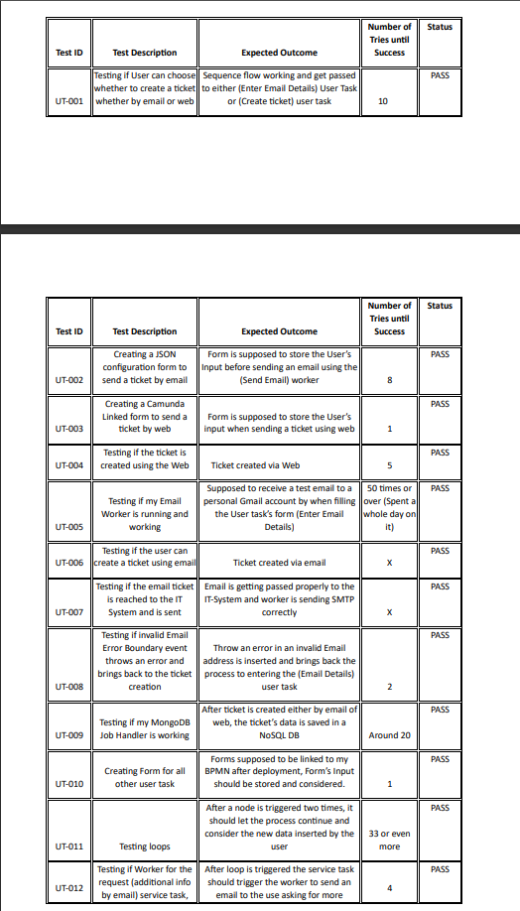
Unit and Integration Testing
3rd Year : DISP : development of Information System’s Project – Presentation Slides By Rayan

Slide 16
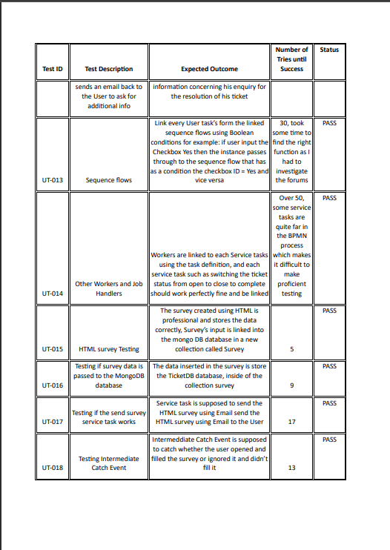
Unit and Integration Testing
3rd Year : DISP : development of Information System’s Project – Presentation Slides By Rayan

Slide 17
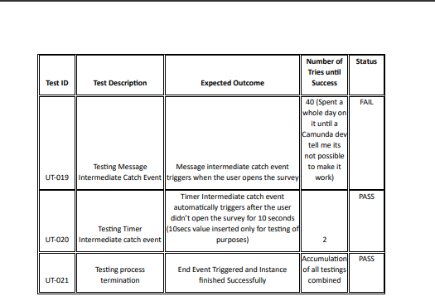
Unit and Integration Testing
3rd Year : DISP : development of Information System’s Project – Presentation Slides By Rayan

Slide 18
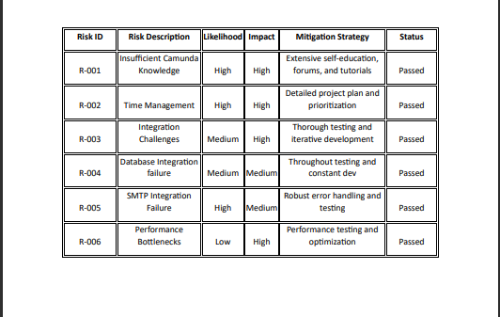
Risk Mitigation
3rd Year : DISP : development of Information System’s Project – Presentation Slides By Rayan

Slide 19
Traceability Matrix
3rd Year : DISP : development of Information System’s Project – Presentation Slides By Rayan

Slide 20
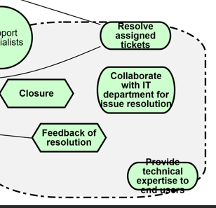
Quality and Configuration Management
Test Plans:
Unit tests, integration tests, user acceptance tests.
Testing environments and methodologies.
Version Control:
Use of Git for version control.
Branching strategy and commit history.
Quality Assurance:
Standards and techniques applied.
Code reviews, continuous integration, and deployment.
3rd Year : DISP : development of Information System’s Project – Presentation Slides By Rayan

Slide 21
Project Reflection Report:
Design Justification:
Rationale behind BPMN design choices.
How design meets client requirements and project goals.
Development Process:
Overview of development phases.
Challenges faced and solutions implemented.
Contributions:
Personal contributions and responsibilities.
Acknowledgement of any external help or resources.
3rd Year : DISP : development of Information System’s Project – Presentation Slides By Rayan

Slide 22
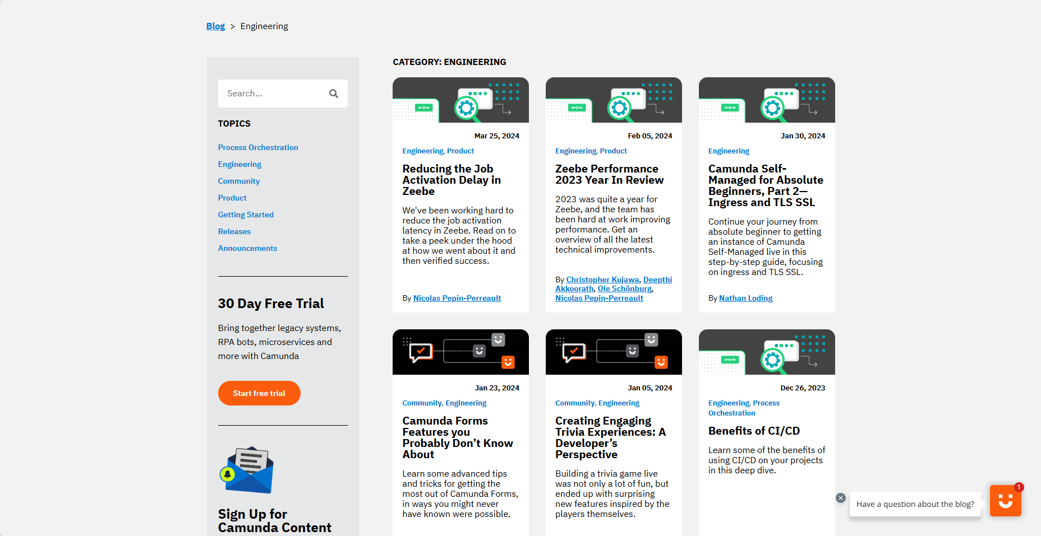
Referencing Resources Used and needed: Camunda Blogs
Link to the Camunda Blogs: https://camunda.com/blog/category/engineering-excellence/
IT Practice: Consultancy Project – Report Workshop - Sustainability

Slide 23
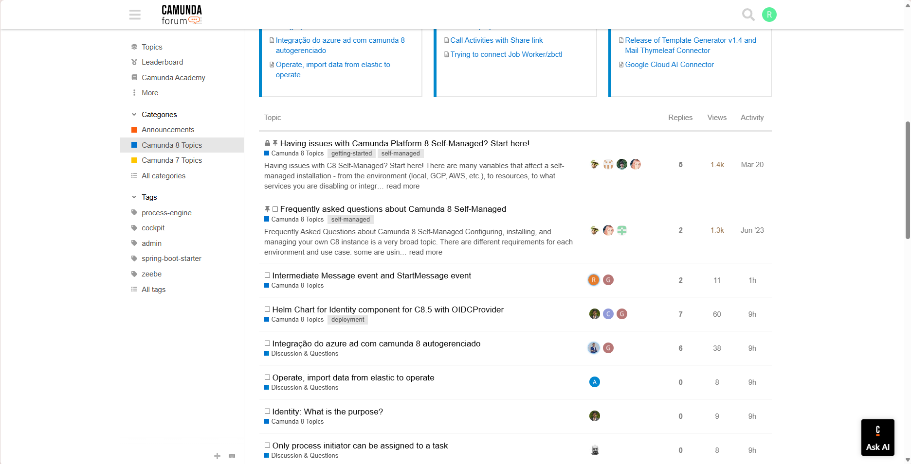
Referencing Resources Used and needed: Camunda Forums
Link to the Camunda Forums: https://forum.camunda.io/c/camunda-platform-8-topics/40
IT Practice: Consultancy Project – Report Workshop - Sustainability

Slide 24
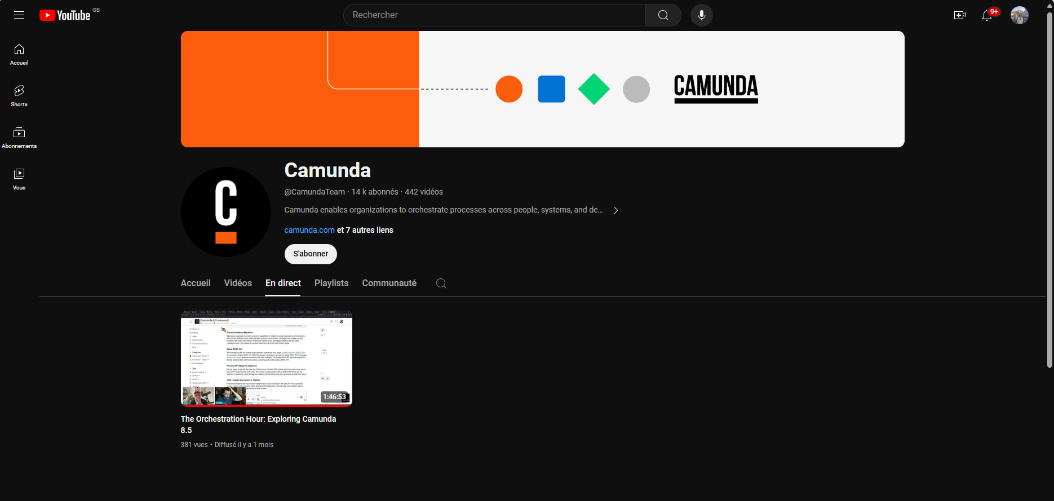
Referencing Resources Used and needed: Camunda’s Official Youtube account
Link to Camunda’s Official Website: https://www.youtube.com/@CamundaTeam/videos
IT Practice: Consultancy Project – Report Workshop - Sustainability

Slide 25
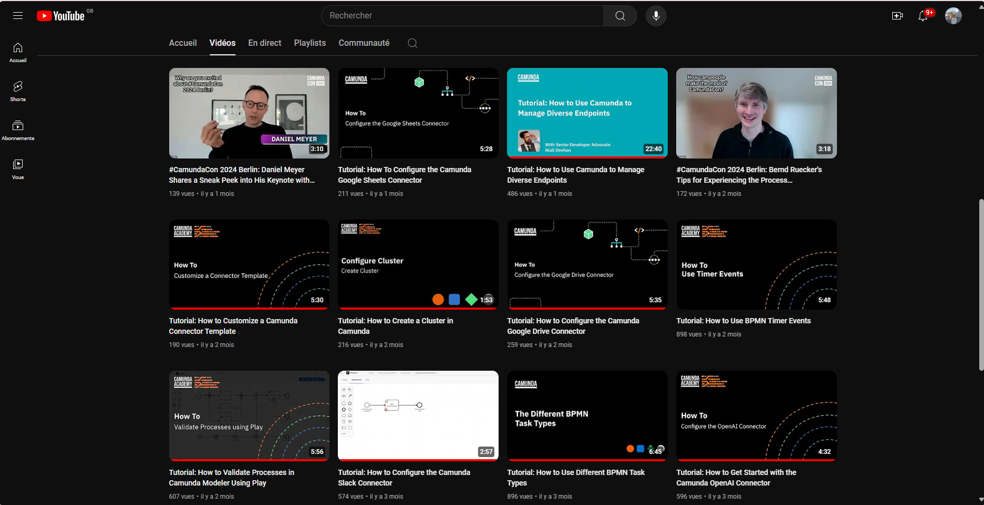
Referencing Resources Used and needed: Camunda’s Official Youtube account
IT Practice: Consultancy Project – Report Workshop - Sustainability

Slide 26
Live Demonstration
3rd Year : DISP : development of Information System’s Project – Presentation Slides By Rayan

Slide 27
Thank you for your Patience and Attention !
IT Practice: Consultancy Project – Report Workshop - Sustainability

